Slide 1
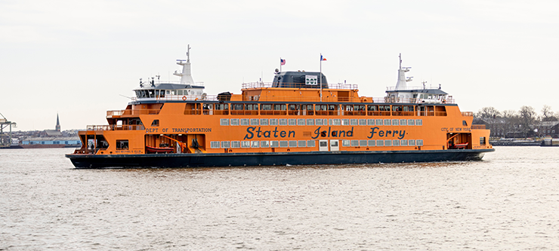
Local Google My Business (GMB/GBP) Optimization
Mat Gargano // StatenWeb

Slide 2
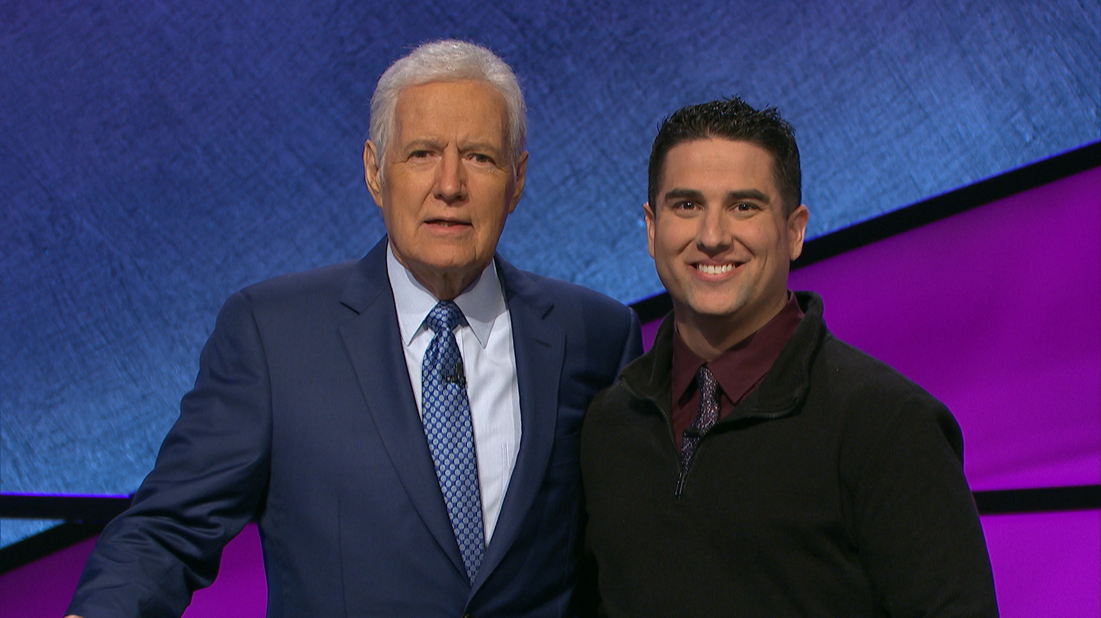
Founded StatenWeb in 2015 after decade+ in agencies
About Mat Gargano
Adjunct Professor of Computer Science at CSI
Native Staten Islander
Did I mention that I was on Jeopardy
GMB // StatenWeb

Slide 3
StatenWeb is a boutique full-service digital marketing agency
Local Digital Agency
Web Design/Development • App Development • Paid Ads • SEO • Local SEO Content Marketing • Email Marketing
Clients Include:
Tunnel to Towers • Salmon Real Estate • Bowl at Rab's • Non Profit Staten Island • SI Shakespearean Theater
ButcherBox • Big Ten Networks • Ossio
GMB // StatenWeb

Slide 4
Key Definitions
Google My Business (GMB)
Google Business Profile (GBP)
Free tool allows you to manage data about your business that shows up in Google's search result
Local Pack/Geopack
The group of businesses that appear in a box at the top of local search results for a particular keyword search.
SEO
Strategies, techniques, and tactics used to improve a website's organic visibility in search engines like Google.
This talk is only about the Local Pack/Geopack
GMB // StatenWeb

Slide 5
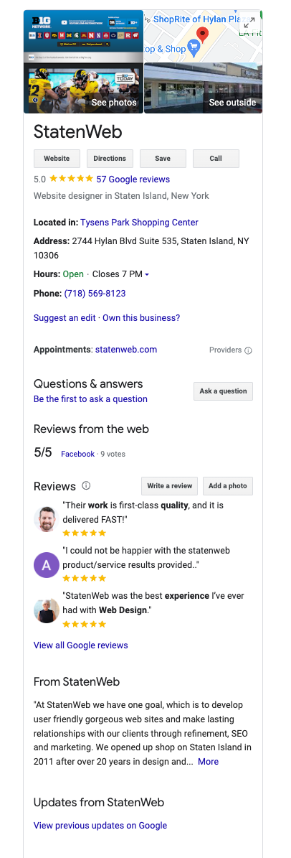
Key Definitions
Google My Business (GMB)
Google Business Profile (GBP)
Free tool allows you to manage data about your business that shows up in Google's search result
Not Just for (Small) Businesses
Do Not Need a Website (personal or business)
Agents (insurance, financial)
GMB // StatenWeb

Slide 6
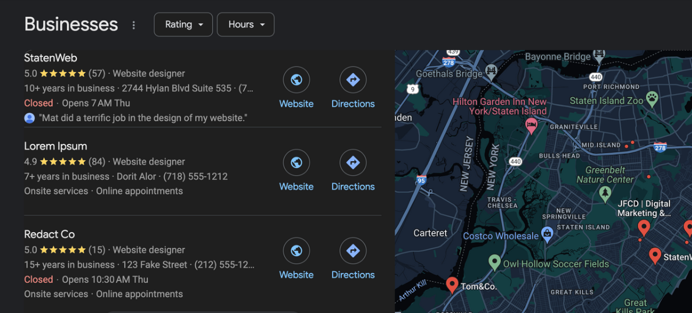
Key Definitions
Local Pack/Geopack
The group of businesses that appear in a box at the top of local search results for a particular keyword search.
GMB // StatenWeb

Slide 7
Key Definitions
Good Side Effects
SEO
Strategies, techniques, and tactics used to improve a website's organic visibility in search engines like Google.
This talk is focused on the Local Pack/Geopack
SERP Visibility
Business Related Searches (“StatenWeb’s Phone Number”)
Mobile search “snapshot”
Customer Interaction (“call”, “website”, “reviews”)
Analytics
Google Maps
GMB // StatenWeb

Slide 8
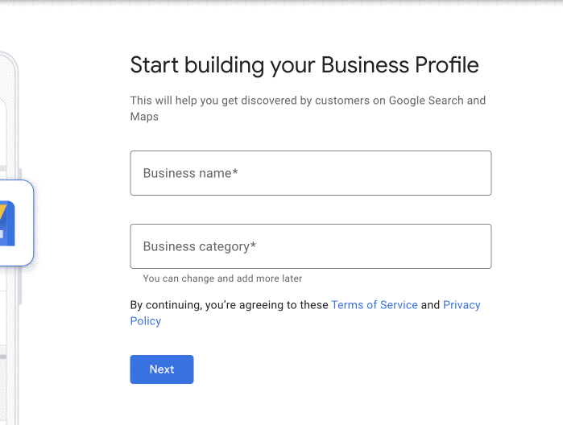
How Do You Get Your Profile?
Go to google.com/business
Click Get Started
Enter Your Business Name
Select or Create (if not Found)
Follow Verification Steps
!DO NOT CREATE DUPLICATE PROFILES!
GMB // StatenWeb

Slide 9
How Do You Get to the Top?
Key Ranking Factors
Primary Category
Keywords in Business Title
Proximity of Address to Searcher
Physical Address in the City Searching
Spam (negative)
Average Google Rating
Additional Categories
Quantity of Reviews (w/ text)
Verifying Your Profile
Proximity of Address to City “Center”
Completeness of Profile
Sustained Influx of Reviews Over Time rather than bursts
GMB // StatenWeb
Source: https://whitespark.ca/local-search-ranking-factors

Slide 10
What Do We Have Immediate Control Over?
Key Ranking Factors
Primary Category
Keywords in Business Title
Proximity of Address to Searcher
Physical Address in the City Searching
Spam (negative)
Average Google Rating
Additional Categories
Quantity of Reviews (w/ text)
Verifying Your Profile
Proximity of Address to City “Center”
Completeness of Profile
Sustained Influx of Reviews Over Time rather than bursts
GMB // StatenWeb
Source: https://whitespark.ca/local-search-ranking-factors

Slide 11
Other Considerations
Key Ranking Factors
Primary Category
Keywords in Business Title
Proximity of Address to Searcher
Physical Address in the City Searching
Spam (negative)
Average Google Rating
Additional Categories
Quantity of Reviews (w/ text)
Verifying Your Profile
Proximity of Address to City “Center”
Completeness of Profile
Sustained Influx of Reviews Over Time rather than bursts
GMB // StatenWeb
Source: https://whitespark.ca/local-search-ranking-factors

Slide 12
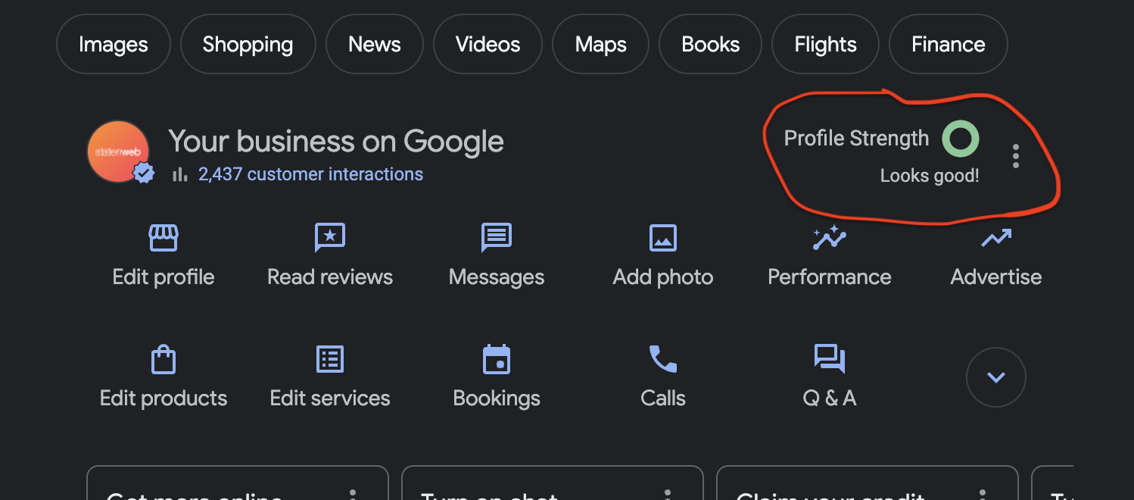
Profile Completeness
Fill out all of your information (duh!)
Edit Profile
Respond to Reviews
Q&A (though not a ranking factor)
GMB // StatenWeb

Slide 13
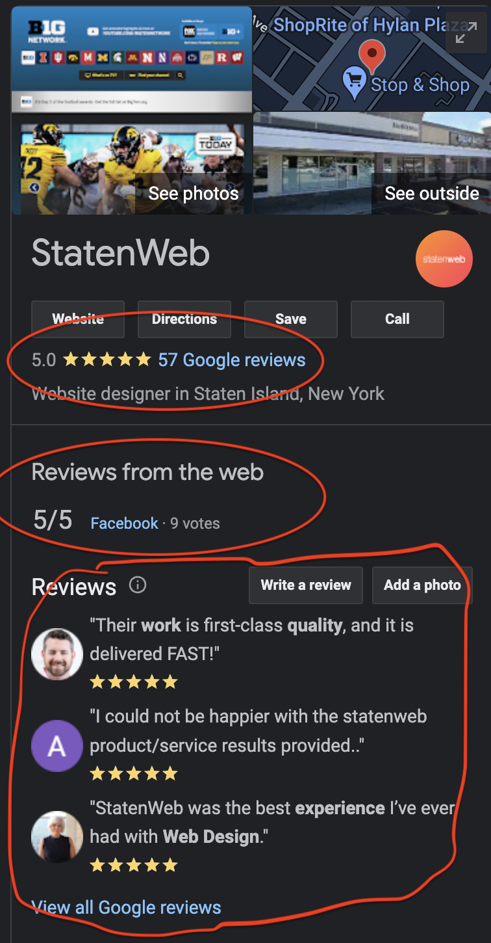
Reviews Are Currency
Have a Plan
Make Part of Your Process
Email Template Ready to Go
Template Example
https://statenweb.com/rotary
GMB // StatenWeb

Slide 14
Questions?
Mat Gargano
statenweb.com
mat@statenweb.com
718-569-8123
Presentation + Review Template @ https://statenweb.com/rotary
GMB // StatenWeb

